Slide 1

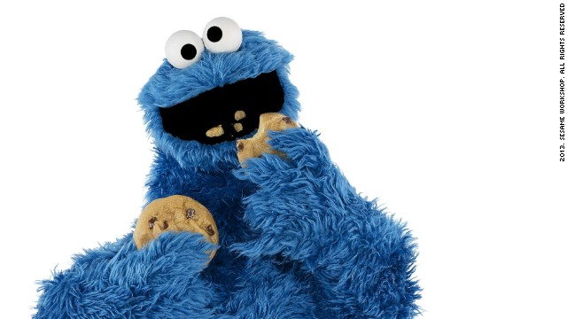
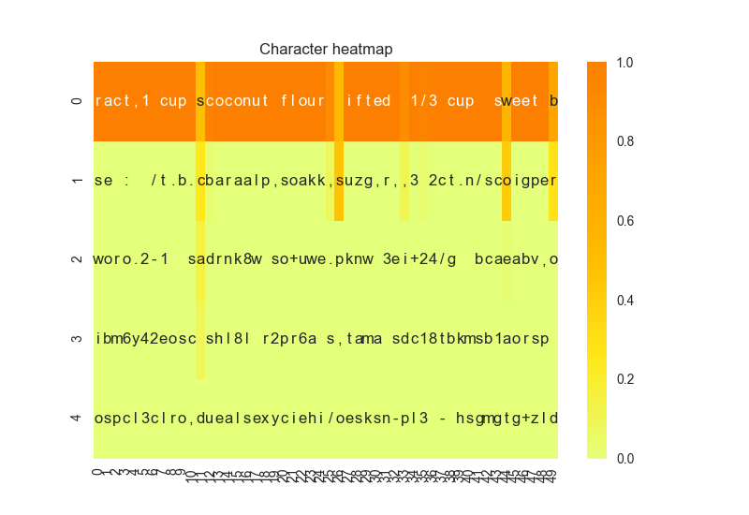
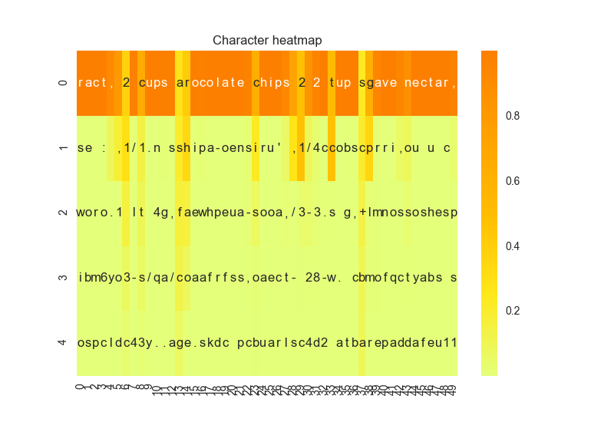
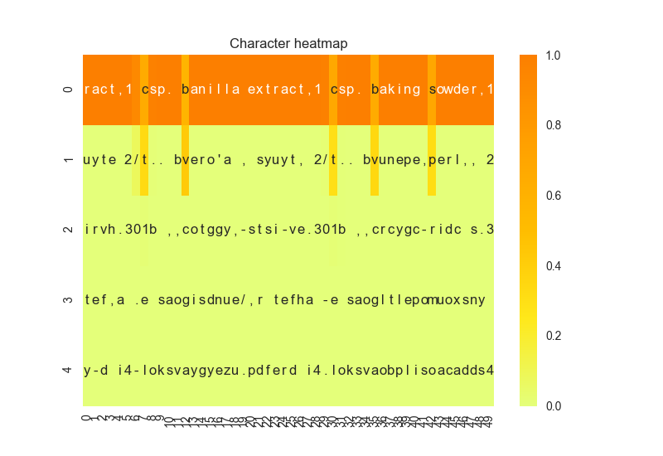
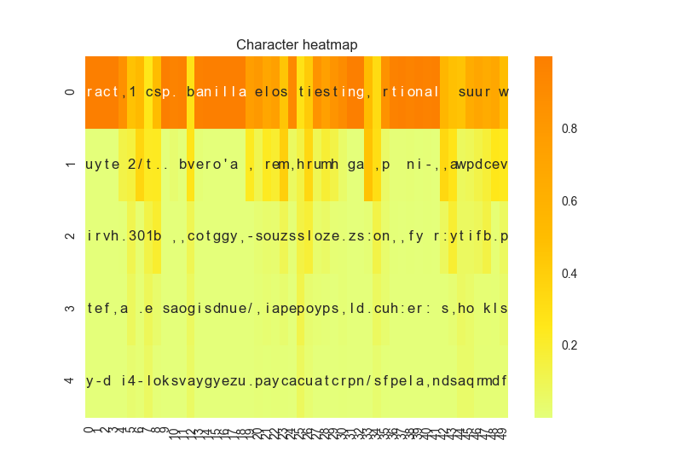
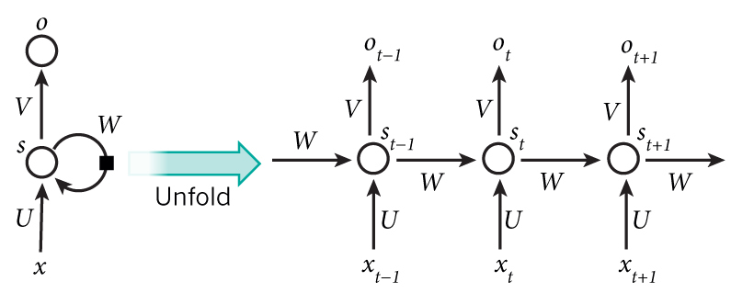
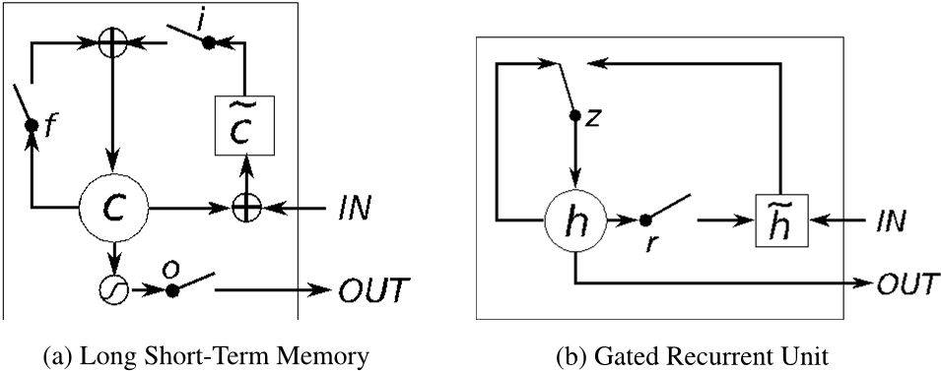
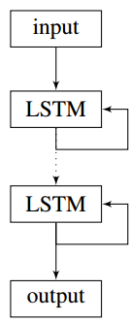
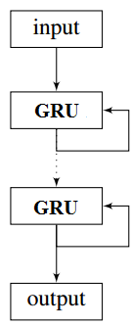
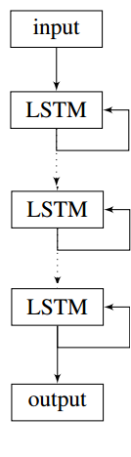
Convectional Neural Networks
Lydia Chang, Stephanie Ger, Ik-Hwan Kim, Craig Ng | MSiA 490-30 Deep Learning | Spring 2017 | Northwestern University
Problem Statement
Technical Approach
Results
Problem:
Creative combination of ingredients can be difficult for most people who lack cooking experience.
With help of machine learning (and a lot of data), a model can generate new recipes for them to experiment with.
Difficulty:
Current machine learning models are effective at copying and regurgitating inputs.
Generating original output from those inputs can be bit more problematic.
Other approaches:
Models have been trained on a very general set of recipes including multiple types of food (both savory and sweet recipes).
Some common ingredient like salt appears in recipes as varied as cakes, burgers and pizzas, confusing the model.
Models trained with both directions and ingredients adds to the complexity and the models focused on learning format rather than content.
Most previous models have utilized character-level generation, which is the most granular and difficult level of generation with regard to text.
Step 1
Step 2
Step 3
Seed text generated from first 40 characters of oatmeal raisin cookie recipe.
Character level embedding with CNN
Preprocess the data
Prepended the title of the recipe to the beginning of the recipe (within brackets) and tab-separated it from the ingredient list, which is comma separated
Created synthetic data by shuffling the ingredient list for each recipe (while retaining the same title) to try and combat dependencies on ingredient order
Consider embedding
Use phrase2vec with different levels of embedding:
character-level
word-level
phrase-level
For character-level, used a sentence of length 40 and a moving frame. For word- and phrase-level, used a sentence of length 50.
Model evaluation
Ran the code with each levels of the embedding for 100 epochs
Evaluate model success by looking at the novel recipes generated by the model
Step 4
Step 5
Step 6
Heat map with diversity = 0.2
Heat map with diversity = 1.2
Character level embedding with LSTM
Hyper-parameter Tuning
Compared GRU and LSTM performance
Varied number of layers in the model (from 2 to 3)
Adjusted the number of hidden neurons in the layers(128,256,512)
Considered bidirectional LSTM for char-RNN model
Generate Recipes
Input a recipe title or keyword and use it search the training data for a matching title.
Randomly select one recipe from the group of recipes that contain the keyword and use those words to seed recipe generation
Compare to actual recipe in training data to see how similar the recipe is
Bake cookies.
Eat cookies.
Profit.
Heat map with diversity = 0.2
Heat map with diversity = 1.2
Current Approach
Recurrent Neural Network (RNN): connections between units form a direct cycle so that it can exhibit dynamic temporal behavior
Figure 1 Illustration of RNN Figure 2 LSTM vs GRU
Long short-term memory (LSTM) improves upon RNNs using memory cells that remember long-term values
Gated recurrent units’ (GRUs) performance is similar to LSTM but the model has fewer parameters, as they lack an output gate
Example Output: 1/2 tsp. baking soda,1 tsp. vanilla extract,1 cup all purpose flour,1 teaspoon baking soda,1 teaspoon salt,6 tablespoons brown sugar,2 cups candy covered plus 1/4 finely diced,1/2 cup firmly packed brown sugar,1 egg 1 3/4 cups sugar,2 la 1/2 tsp. baking soda,1 tsp. vanilla extract 2 cups chocolate chips,1/2 cup agave nectar,1 teaspoon coconut extract ,1 teaspoon salt,1 cup nutella, 1/2 cup rainbow sprinkles of chopped nuts,1/3 cup chocolate hot cocoa powder,1 tsp vanilla
Dataset
Conclusion
Yummly’s API (a recipe repository) provided 90,000 ingredient lists for the search parameter ‘cookie’.
Data was cleaned for better performance:
Removed any recipes that didn’t have cookie in the title
Removed special characters and converted from Unicode to ASCII
Created a dictionary of words by looking at the term frequency matrix of the corpus and removing any infrequent (<100) terms
Inspected the final dictionary and removed any words that were instructions or were unrelated to cookies
Removed any words not in the final dictionary from the corpus
Example raw observation:
Example post-processed observation:
Brief summary of what you discovered based on results
Difficult to produce legitimate recipes using character-level embedding
Word2vec provides the best balance between legibility and creativity
Limitations of approach
Dictionary limited to those words/recipes available via the Yummly API
How to improve/future work
Generalize to include other types of food (e.g., muffins, cakes), then use combination of words specific to each type to seed recipe generation
Train model to classify recipes based on ingredients
Include directions to give full recipes
Convert all fractions to decimals (e.g., ¾ to 0.75)
['2 cups flour', '1 teaspoon baking powder', '1 teaspoon baking soda', '1 teaspoon salt', '3/4 cup butter, room temperature', '3/4 cup brown sugar (packed)', '3/4 cup granulated sugar', '2 large eggs', u'2 teaspoons vanilla (or slightly more, to taste)', '3 1/2 cups old-fashioned oatmeal', '2 cups raisins (soaked in hot water flavored with vanilla, then drained)']
Alternative Approach
Bidirectional RNN: connect two hidden layers of opposite directions to the same output, so the output layer can get information from both past (left context) and future (right context) states
Dynamic Convolutional NN: the connectivity pattern between its neurons is just like animal visual cortex. This network can be used to do sentence modeling.
References and Related Work
[Favorite Oatmeal Raisin Cookies] 2 cups flour,1 teaspoon baking powder,1 teaspoon baking soda,1 teaspoon salt,3/4 cup butter room temperature,3/4 cup brown sugar ,3/4 cup granulated sugar,2 large eggs,2 teaspoons vanilla ,3 1/2 cups old-fashioned oatmeal,2 cups raisins
Do Androids Dream of Cooking? (Tom Brewe)
Keras LSTM Text Generation Example Code (François Chollet)
Word RNN Tensorflow Code (Sung Kim)
The Unreasonable Effectiveness of Recurrent Neural Networks (Andrej Karpathy)
Generating Text with Recurrent Neural Networks (Ilya Sutskever, James Martens, Geoffrey Hinton
Figure 3 The structures of our models

